Slide 1


ML/DL for Everyone with
Lecture 3: Gradient Descent

Slide 2
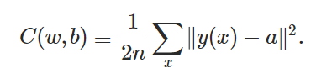
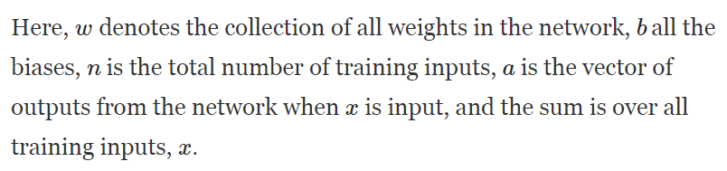
Loss(Cost) Function
Notes:
loss = (\hat{y}-y)^2 = (x*w-y)^2

Slide 3
Loss(Cost) Function
||v|| denotes a distance of a vector → A scalar
Square value → means it is always positive.
a = wx + b → A function of weights and biases.
The reason that the cost function doesn’t’ use an ‘absolute’ function is for smoothness. → Easy to calculate derivatives.
Notes:
loss = (\hat{y}-y)^2 = (x*w-y)^2

Slide 4


Loss(Cost) Function
Notes:
loss = (\hat{y}-y)^2 = (x*w-y)^2

Slide 5
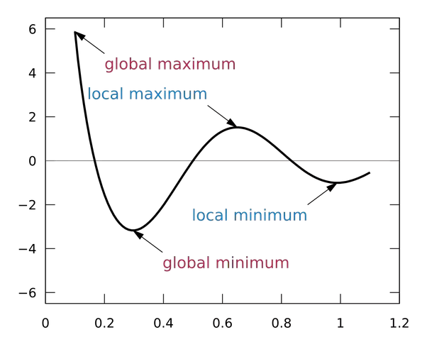
Find global minimum
Notes:
loss = (\hat{y}-y)^2 = (x*w-y)^2

Slide 6
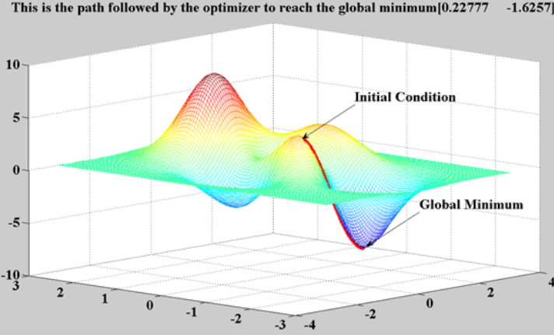
Find global minimum
Notes:
loss = (\hat{y}-y)^2 = (x*w-y)^2

Slide 7
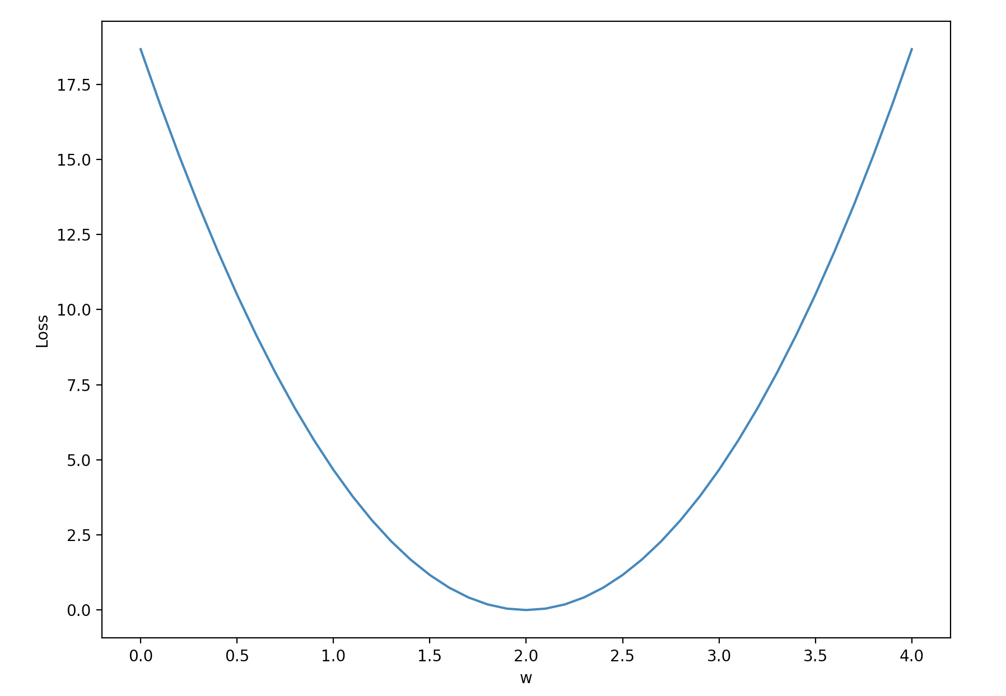
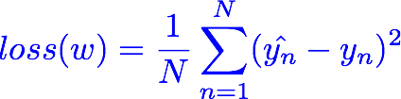
Loss(Cost) Function two dimension
Notes:
loss = (\hat{y}-y)^2 = (x*w-y)^2

Slide 8
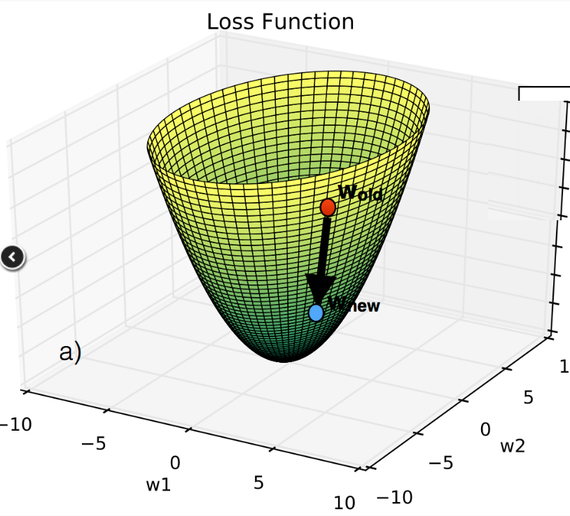
Loss(Cost) Function three dimension
Notes:
loss = (\hat{y}-y)^2 = (x*w-y)^2

Slide 9

Loss(Cost) Function n dimension
Notes:
loss = (\hat{y}-y)^2 = (x*w-y)^2

Slide 10
Problem Attacker
When there are no obvious MATH way to solve this problem, we switch to COMPUTER way.
Step by Step
Notes:
loss = (\hat{y}-y)^2 = (x*w-y)^2

Slide 11
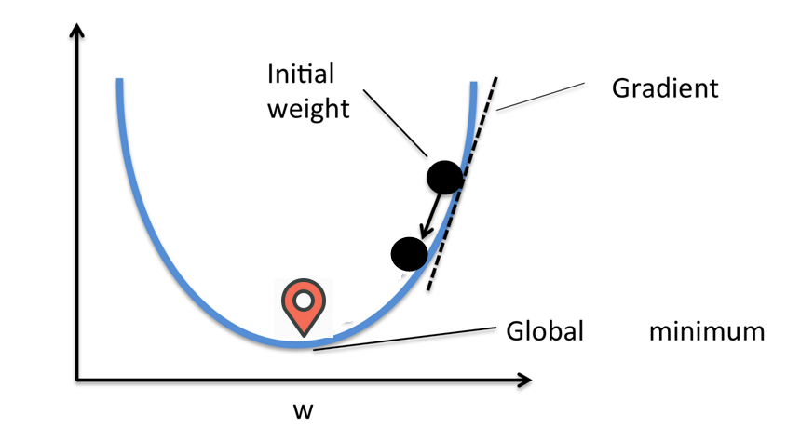
Move down a little step by step
For two dimension space, there is only ONE direction toward the bottom of global minimum, it is the tangent line direction.
Notes:
loss = (\hat{y}-y)^2 = (x*w-y)^2
\frac{\partial{loss}}{\partial{w}}=?

Slide 12
Find a point first Then find next point
Find a random point first, and try to find the next point that goes down the fastest. Repeat this procedure until we reach the global minimum.
Notes:
loss = (\hat{y}-y)^2 = (x*w-y)^2

Slide 13
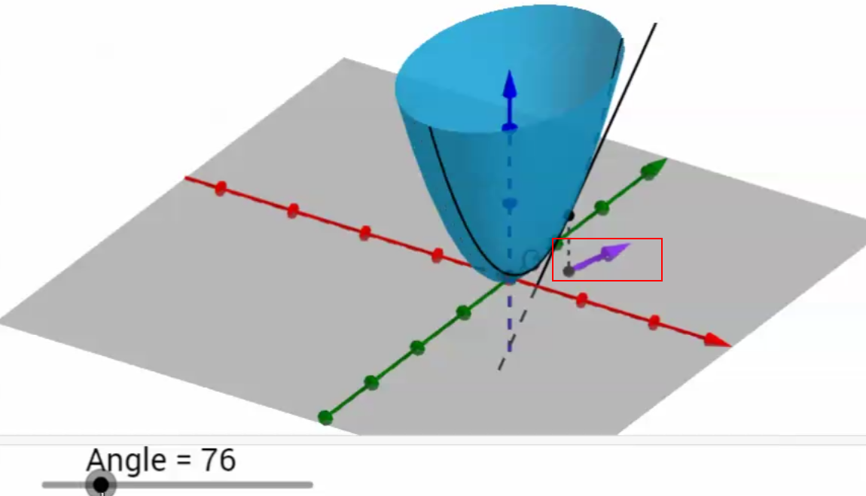
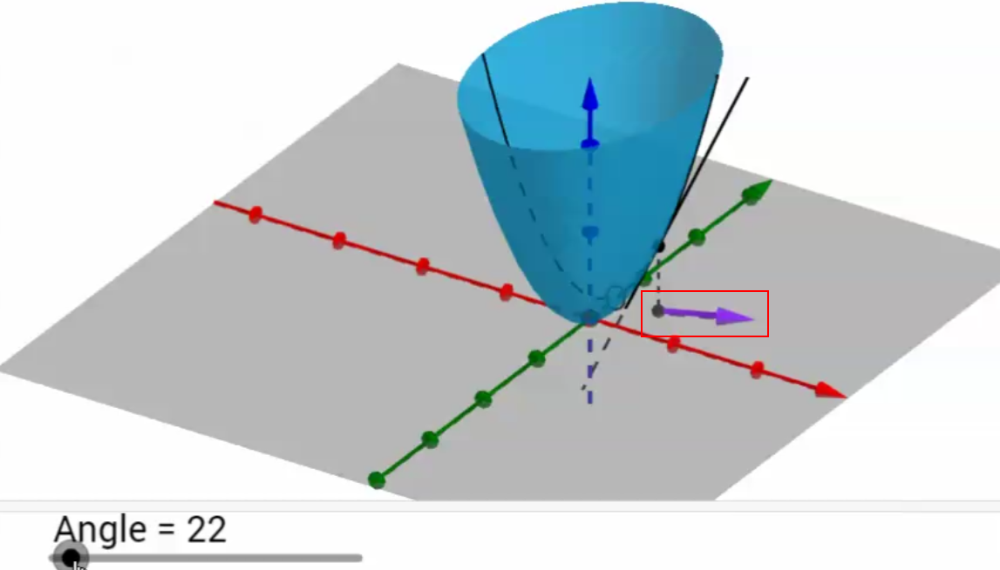
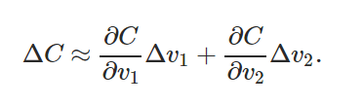
Move down a little step by step
For n dimension space, there are INFINITE directions toward the bottom of global minimum.
WHICH DIRECTION TO GO DOWN TO BOTTOM THE FASTEST?
Notes:
loss = (\hat{y}-y)^2 = (x*w-y)^2
\frac{\partial{loss}}{\partial{w}}=?

Slide 14


Slide 15
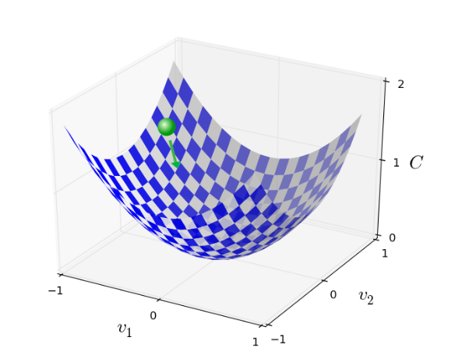
The Gradient Descent

Slide 16
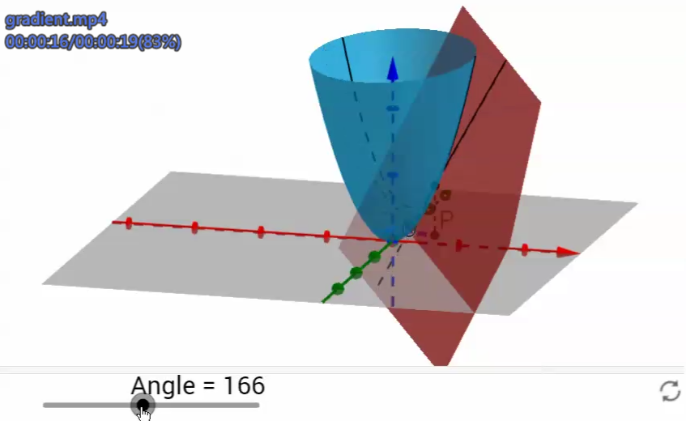
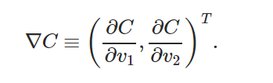
The Tangent Plane
On a single point, there is ONLY ONE plane tangent to the point. However there are INFINITE lines tangent to that point on that only plane..
The tangent line that has the maximum slope is called GRADIENT.

Slide 18
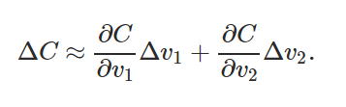
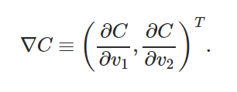



The Gradient Descent

Slide 19
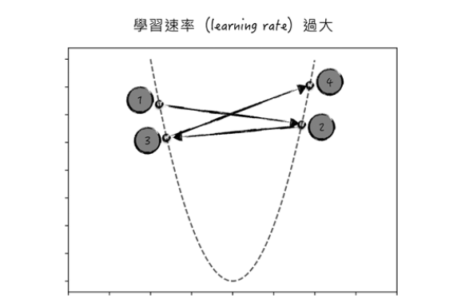
Carefully choosing

Slide 20
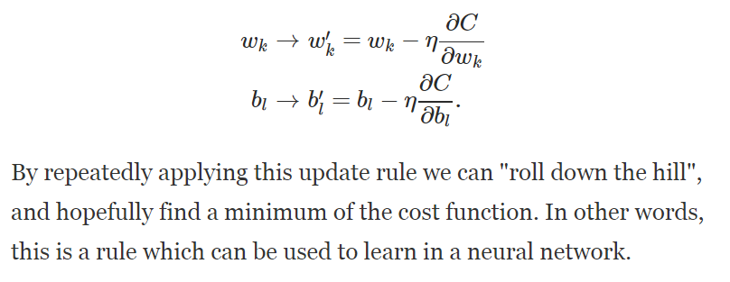
The Gradient Descent

Slide 21
The Gradient Descent

Slide 22

The Problem of Gradient Descent
We need to compute the gradients ∇Cx separately for each training input, x, and then average them
When the number of training inputs is very large this can take a long time

Slide 23
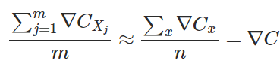
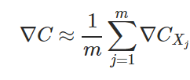
Stochastic Gradient Descent(SGD)
Choose a small m number of training inputs → MINI BATCH
Calculate the gradient of the mini batch, which equals to the real gradient of all samples.
When we have completed all the batches once, it’s called an EPOCH
After that we start a new epoch.

Slide 24
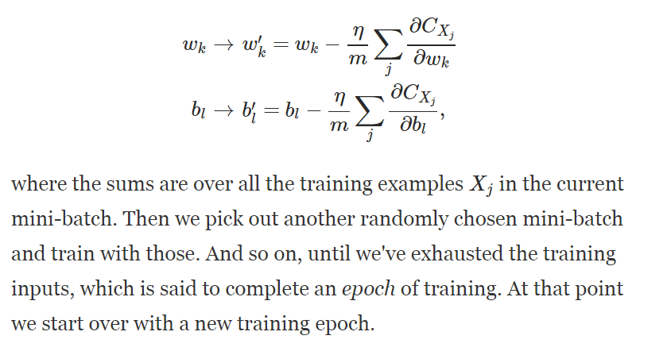
Stochastic Gradient Descent(SGD)

Slide 25

Stochastic Gradient Descent(SGD)
It is like political POLLING, easier to get small number of sample vs. all samples
For MNIST, choose a mini-batch of size 10, for 60000 samples.
The gradient of the mini batch is NOT perfect, but good enough to do SGD.
Only need 6000 times to get the true gradient.

Slide 26
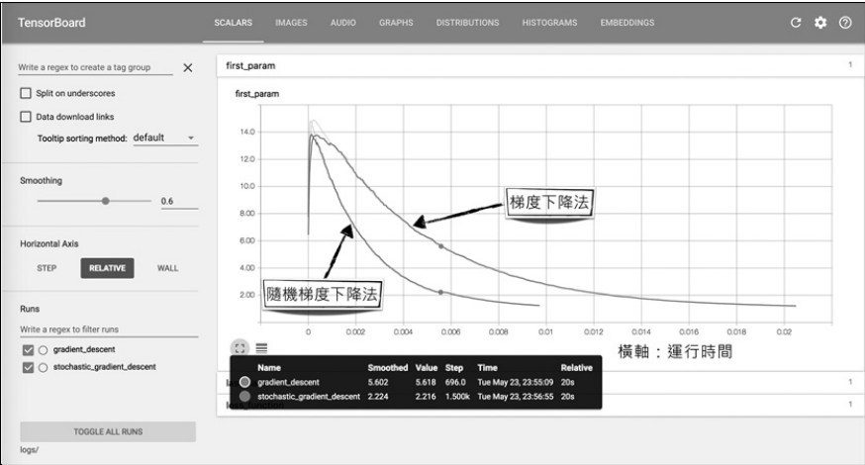
SGD: Faster Converging

Slide 27
Loss graph
Loss (w=0) | Loss (w=1) | Loss (w=2) | Loss (w=3) | Loss (w=4)
mean=56/3=18.7 | mean=14/3=4.7 | mean=0 | mean=14/3=4.7 | mean=56/3=18.7
Notes:
loss = (\hat{y}-y)^2 = (x*w-y)^2

Slide 28
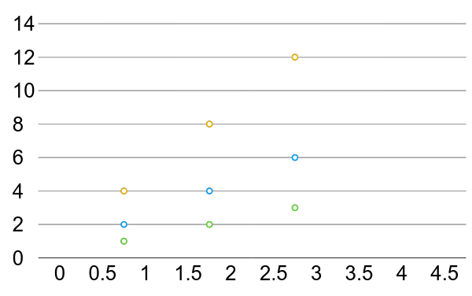
Linear Regression error?

Slide 29

What is the learning: find w that minimizes the loss
Loss (w=0) | Loss (w=1) | Loss (w=2) | Loss (w=3) | Loss (w=4)
mean=56/3=18.7 | mean=14/3=4.7 | mean=0 | mean=14/3=4.7 | mean=56/3=18.7
Notes:
loss = (\hat{y}-y)^2 = (x*w-y)^2

Slide 30
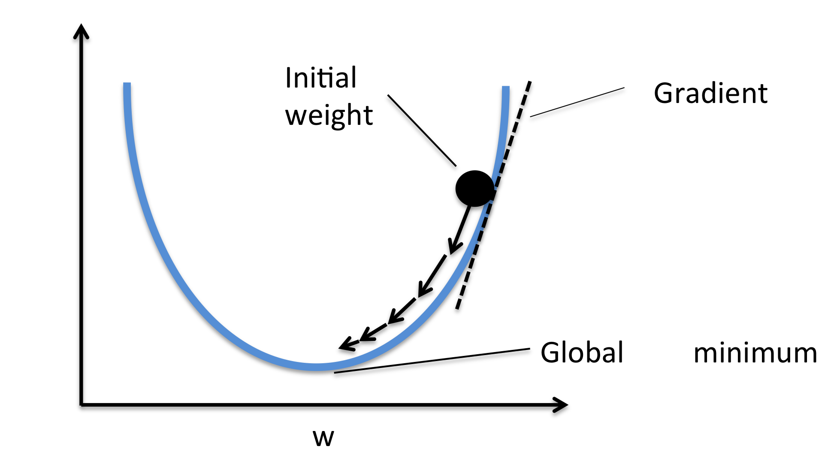

Gradient descent algorithm
loss
loss
Notes:
loss = (\hat{y}-y)^2 = (x*w-y)^2
\frac{\partial{loss}}{\partial{w}}=?

Slide 31


Gradient descent algorithm
loss
loss
Notes:
loss = (\hat{y}-y)^2 = (x*w-y)^2
\frac{\partial{loss}}{\partial{w}}=?

Slide 32
Derivative
Notes:
loss = (\hat{y}-y)^2 = (x*w-y)^2
\frac{\partial{loss}}{\partial{w}}=?

Slide 33

Derivative
Notes:
loss = (\hat{y}-y)^2 = (x*w-y)^2
\frac{\partial{loss}}{\partial{w}}=?

Slide 34
Derivative
Notes:
loss = (\hat{y}-y)^2 = (x*w-y)^2
\frac{\partial{loss}}{\partial{w}}=?

Slide 35
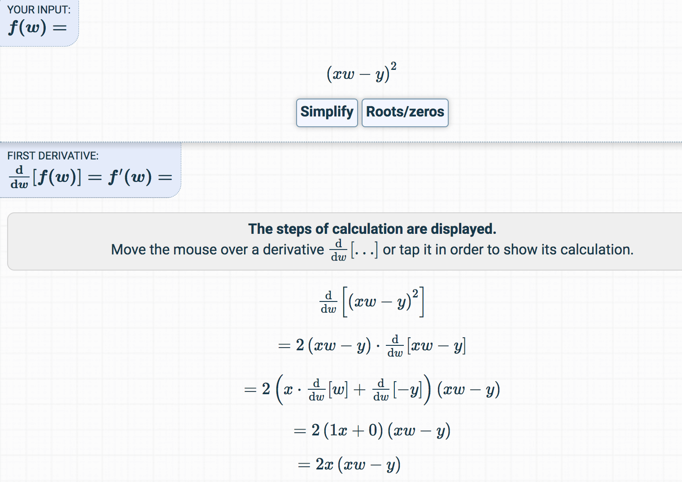
Derivative
https://www.derivative-calculator.net/
Notes:
loss = (\hat{y}-y)^2 = (x*w-y)^2
\frac{\partial{loss}}{\partial{w}}=?

Slide 36


Let’s implement!
loss
loss
Notes:
loss = (\hat{y}-y)^2 = (x*w-y)^2
\frac{\partial{loss}}{\partial{w}}=?

Slide 37

Data, Model, Loss, and Gradient
x_data = [1.0, 2.0, 3.0]
y_data = [2.0, 4.0, 6.0]
w = 1.0 # a random guess: random value
# our model forward pass
def forward(x):
return x * w
# Loss function
def loss(x, y):
y_pred = forward(x)
return (y_pred - y) * (y_pred - y)
# compute gradient
def gradient(x, y): # d_loss/d_w
return 2 * x * (x * w - y)
Notes:
=w-\alpha*2x(xw-y)

Slide 38
Training: updating weight
x_data = [1.0, 2.0, 3.0]
y_data = [2.0, 4.0, 6.0]
w = 1.0 # a random guess: random value
# our model forward pass
def forward(x):
return x * w
# Loss function
def loss(x, y):
y_pred = forward(x)
return (y_pred - y) * (y_pred - y)
# compute gradient
def gradient(x, y): # d_loss/d_w
return 2 * x * (x * w - y)
# Before training
print("predict (before training)", 4, forward(4))
# Training loop
for epoch in range(100):
for x_val, y_val in zip(x_data, y_data):
grad = gradient(x_val, y_val)
w = w - 0.01 * grad
print("\tgrad: ", x_val, y_val, grad)
l = loss(x_val, y_val)
print("progress:", epoch, "w=", w, "loss=", l)
# After training
print("predict (after training)", "4 hours", forward(4))

Slide 39
Output
(from gradient numeric computation)
predict (before training) 4 4.0
grad: 1.0 2.0 -2.0
grad: 2.0 4.0 -7.84
grad: 3.0 6.0 -16.23
progress: 0 w= 1.26 loss= 4.92
grad: 1.0 2.0 -1.48
grad: 2.0 4.0 -5.8
grad: 3.0 6.0 -12.0
progress: 1 w= 1.45 loss= 2.69
grad: 1.0 2.0 -1.09
grad: 2.0 4.0 -4.29
grad: 3.0 6.0 -8.87
progress: 2 w= 1.6 loss= 1.47
grad: 1.0 2.0 -0.81
grad: 2.0 4.0 -3.17
grad: 3.0 6.0 -6.56
..
progress: 7 w= 1.91 loss= 0.07
grad: 1.0 2.0 -0.18
grad: 2.0 4.0 -0.7
grad: 3.0 6.0 -1.45
progress: 8 w= 1.93 loss= 0.04
grad: 1.0 2.0 -0.13
grad: 2.0 4.0 -0.52
grad: 3.0 6.0 -1.07
progress: 9 w= 1.95 loss= 0.02
predict (after training) 4 hours 7.80
# Before training
print("predict (before training)", 4, forward(4))
# Training loop
for epoch in range(100):
for x_val, y_val in zip(x_data, y_data):
grad = gradient(x_val, y_val)
w = w - 0.01 * grad
print("\tgrad: ", x_val, y_val, grad)
l = loss(x_val, y_val)
print("progress:", epoch, "w=", w, "loss=", l)
# After training
print("predict (after training)", "4 hours", forward(4))

Slide 40
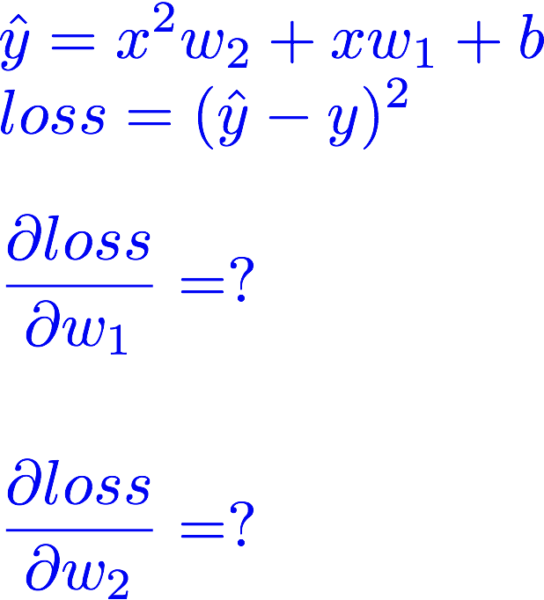
Exercise :compute gradient

Slide 41



